Slide 1
6.3- Mining Social Network Graphs: Social Networks as Graphs, Clustering of Social-Network Graphs, Direct Discovery of Communities in a social graph.
Adapted from Mining of Massive Datasets
Jure Leskovec, Anand Rajaraman, Jeff Ullman Stanford University
http://www.mmds.org

Slide 2
What is Social Network?
When we think of a social network, we think of Facebook, Twitter, Google+, or another website that is called a “social network,” and indeed this kind of network is representative of the broader class of networks called “social.”
Characteristics of Social Network
There is a collection of entities that participate in the network.
There is at least one relationship between entities of the network.
There is an assumption of nonrandomness or locality.

Slide 3
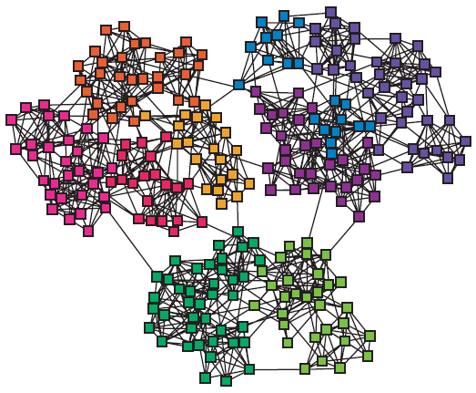
Networks & Communities
We often think of networks being organized into modules, cluster, communities:

Slide 4
Varieties of Social Network
Telephone Networks
Email Networks
Collaboration Networks
Information networks (documents, web graphs, patents)
Infrastructure networks (roads, planes, water pipes, powergrids)
Biological networks (genes, proteins, food-webs of animals eating each other)
Product co-purchasing networks (e.g., Groupon)

Slide 5
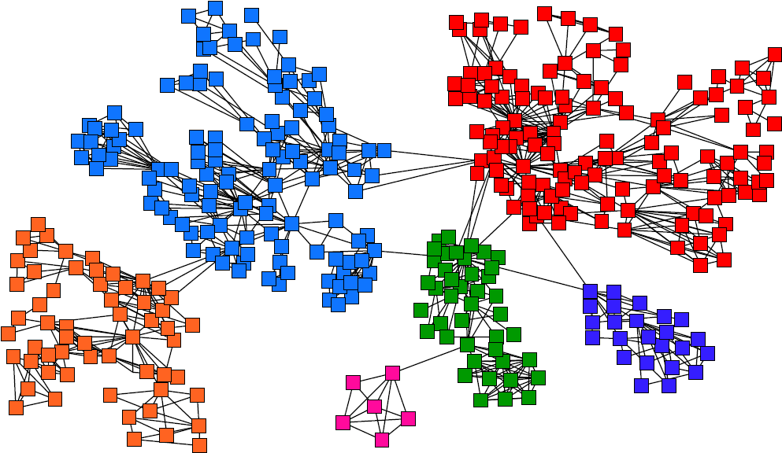
Goal: Find Densely Linked Clusters

Slide 6
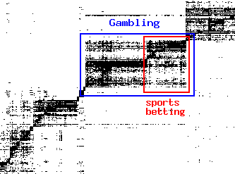
Applications-1
Find micro-markets by partitioning the query-to-advertiser graph:
query
advertiser
[Andersen, Lang: Communities from seed sets, 2006]

Slide 7
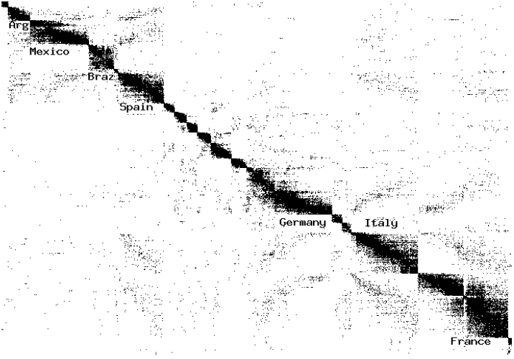
Applications-2
Clusters in Movies-to-Actors graph:
[Andersen, Lang: Communities from seed sets, 2006]

Slide 8
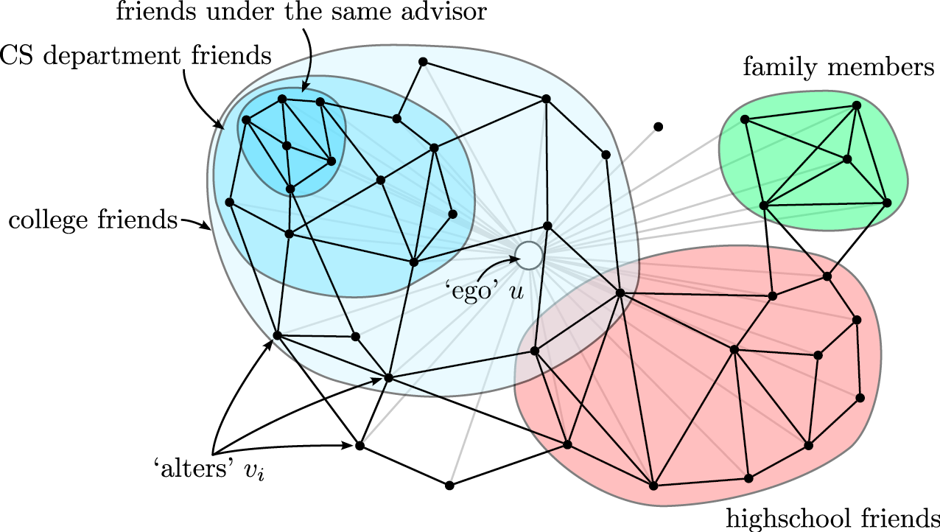
Application-3
Discovering social circles, circles of trust:
[McAuley, Leskovec: Discovering social circles in ego networks, 2012]

Slide 9
Social Network as Graph
Social networks are naturally modeled as graphs, which we sometimes refer to as a social graph.
Difference between Facebook and Twitter graph?
Different graph types with several node types.
Example: In Collaboration Networks
Nodes represent individuals who have published research papers.
There is an edge between two individuals who published one or more papers jointly. The communities in this network are authors working on a particular topic.
An alternative view of the same data is as a graph in which the nodes are papers.
Two papers are connected by an edge if they have at least one author in common. Now, we form communities that are collections of papers on the same topic.

Slide 10
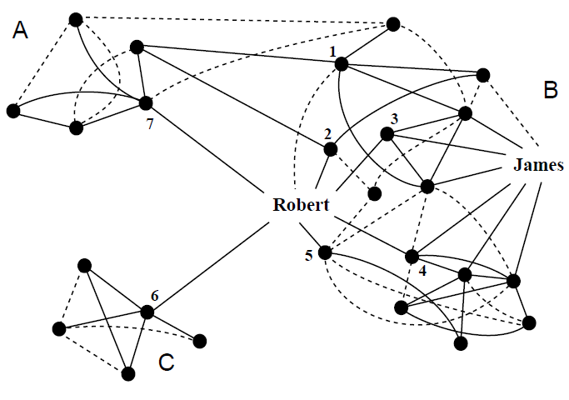
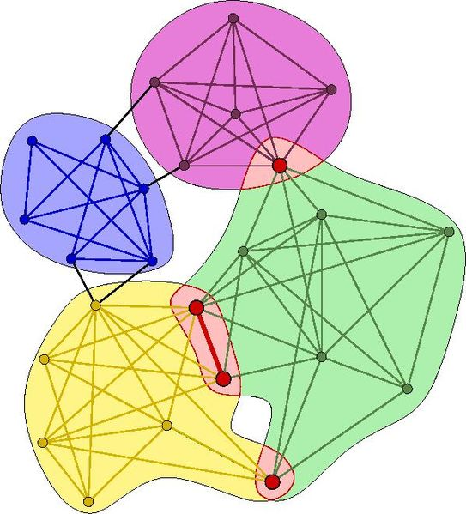
Clustering of Social Network Graphs
How to find communities?

Slide 11
Problems with standard techniques
Distance Measures for Social-Network Graphs
If we were to apply standard clustering techniques to a social-network graph, our first step would be to define a distance measure.
Social graphs violate the triangle inequality.
Applying Standard Clustering Methods
Hierarchical Clustering: The fact that all edges are at the same distance will introduce number of random factors that will lead to some nodes being assigned to the wrong cluster.
K-means Clustering: Hard to pick up two points that are far away.

Slide 12
Betweenness
Edge betweenness: Number of shortest paths passing over the edge
Betweenness of an edge (a, b) is the number of pairs of nodes x and y such that the edge (a, b) lies on the shortest path between x and y.
Which edge will have highest betweenness?

Slide 13
Betweenness - Example
The edge (B, D) has the highest betweenness. In fact, this edge is on every shortest path between any of A, B, and C to any of D, E, F, and G. Its betweenness is therefore 3 × 4 = 12.
In contrast, the edge (D, F) is on only four shortest paths: those from A, B, C, and D to F.

Slide 14
Girvan-Newman Algorithm
Divisive hierarchical clustering based on the notion of edge betweenness:
Number of shortest paths passing through the edge
Girvan-Newman Algorithm:
Undirected unweighted networks
Repeat until no edges are left:
Calculate betweenness of edges
Remove edges with highest betweenness
Connected components are communities
Gives a hierarchical decomposition of the network

Slide 15
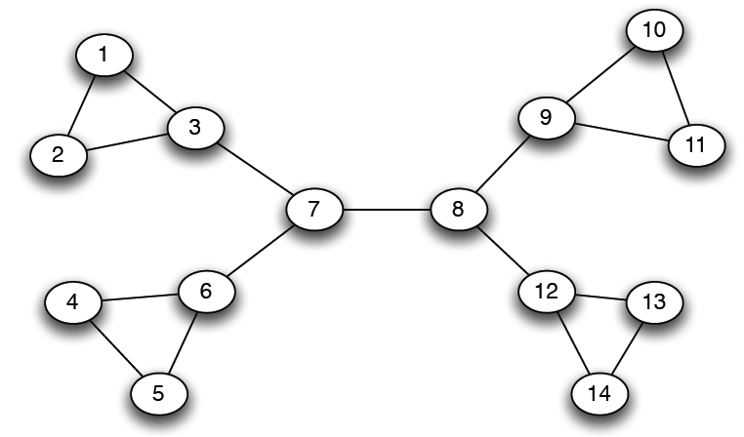
Girvan-Newman: Example
12
1
33
49
Need to re-compute betweenness at every step

Slide 16
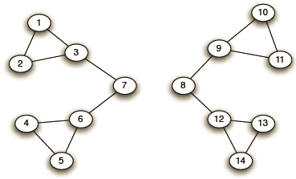
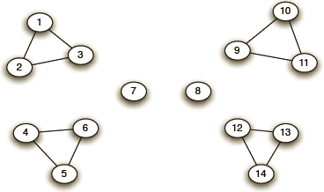
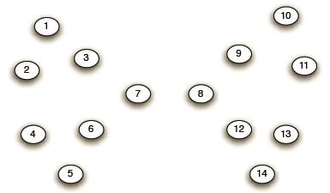
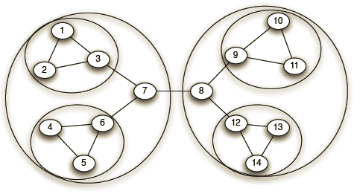
Girvan-Newman: Example
Step 1:
Step 2:
Step 3:
Hierarchical network decomposition:

Slide 17
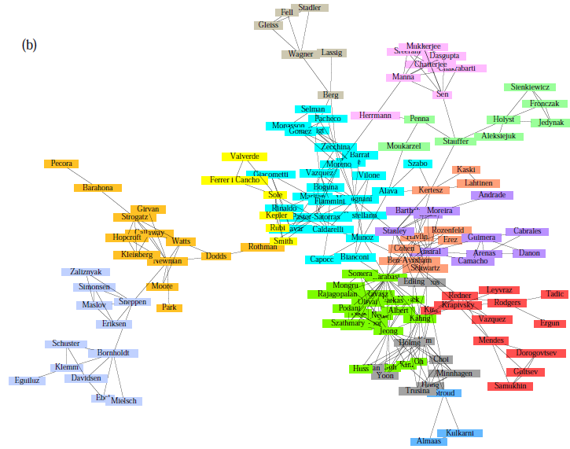
Girvan-Newman: Results
Communities in physics collaborations

Slide 18
Girvan-Newman: Example
Consider the graph:
Step1: Applying BFS
Step2: Labelling nodes with
number of paths from root
Example: with E as the root →

Slide 19
Girvan-Newman: Example
Step 3 (Final Step for one node): Credit calculation from leaf to the root.

Slide 20
Girvan-Newman: Example
The credit on each of the edges is the contribution to the betweenness of that edge due to shortest paths from E. For example (from previous slide), this contribution for the edge (E, D) is 4.5.
To complete the betweenness calculation
Repeat this calculation for every node as the root and sum the contributions.
Finally, divide by 2 to get the true betweenness, since every shortest path will be discovered twice, once for each of its endpoints.

Slide 21
Girvan-Newman: Final Solution
Highest score is of edge(B, D) and hence the 2 communities are {A, B, C} and {D, E, F, G}

Slide 22
Direct Discovery of Communities

Slide 23
Trawling
[Kumar et al. ‘99]
Searching for small communities in the Web graph
What is the signature of a community / discussion in a Web graph?
Use this to define “topics”:
What the same people on the left talk about on the right
Remember HITS!
…
…
…
Dense 2-layer graph
Intuition: Many people all talking about the same things

Slide 24
Searching for Small Communities
A more well-defined problem: Enumerate complete bipartite subgraphs K_{s,t}
Where K_{s,t} : s nodes on the “left” where each links to the same t other nodes on the “right”
|X| = s = 3
|Y| = t = 4
X
Y
K_{3,4}
Fully connected

Slide 25
Frequent Itemset Enumeration
[Agrawal-Srikant ‘99]
Market basket analysis. Setting:
Market: Universe U of n items
Baskets: m subsets of U: S₁, S₂, …, S_{m} ⊆ U (S_{i} is a set of items one person bought)
Support: Frequency threshold f
Goal:
Find all subsets T s.t. T ⊆ S_{i} of at least f sets S_{i} (items in T were bought together at least f times)
What’s the connection between the itemsets and complete bipartite graphs?

Slide 26
From Itemsets to Bipartite K_{s,t}
[Kumar et al. ‘99]
Frequent itemsets = complete bipartite graphs!
How?
View each node i as a set S_{i} of nodes i points to
K_{s,t} = a set Y of size t that occurs in s sets S_{i}
Looking for K_{s,t} → set of frequency threshold to s and look at layer t – all frequent sets of size t
a
b
S_{i}={a,b,c,d}
i
c
d
a
j
b
i
c
k
d
X
Y
s … minimum support (|X|=s)
t … itemset size (|Y|=t)

Slide 27
From Itemsets to Bipartite K_{s,t}
[Kumar et al. ‘99]
View each node i as a set S_{i} of nodes i points to
Say we find a frequent itemset Y={a,b,c} of supp s So, there are s nodes that link to all of {a,b,c}:
a
b
i
c
a
a
d
b
a
S_{i}={a,b,c,d}
b
x
y
z
c
c
b
Find frequent itemsets:
s … minimum support
t … itemset size
c
We found K_{s,t}!
K_{s,t} = a set Y of size t that occurs in s sets S_{i}
a
x
b
y
c
z
Y
X

Slide 28
Example
a
b
Support threshold s=2
{b,d}: support 3
{e,f}: support 2
And we just found 2 bipartite subgraphs:
c
d
e
f
Itemsets:
a = {b,c,d}
b = {d}
c = {b,d,e,f}
d = {e,f}
e = {b,d}
f = {}
a
b
c
d
c
d
e
f
e

